Slide 1

Hajj Helper
Team: Khalid Family

Slide 2
Project Overview
App Overview:
This app will help you navigate, contact people, and give helpful tips so you can make the most out of the blessed Hajj.
Target Customers:
Every Muslim with a smartphone planning on visiting Saudi Arabia for Umrah/Hajj.
App Functionality:
Send location
Map view
More
Helpful tips
Emergency Call
Hajj Steps

Slide 3
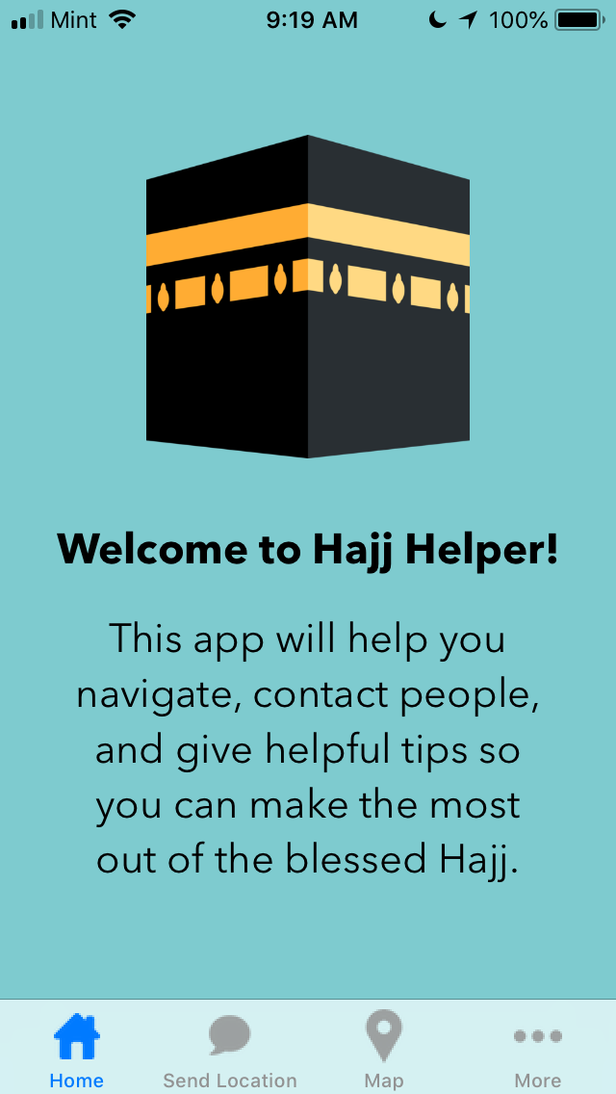
Home Page

Slide 4
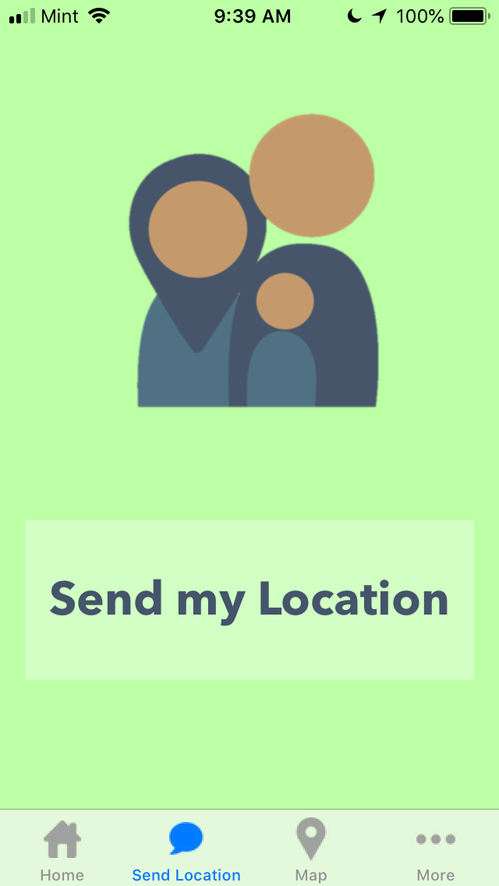
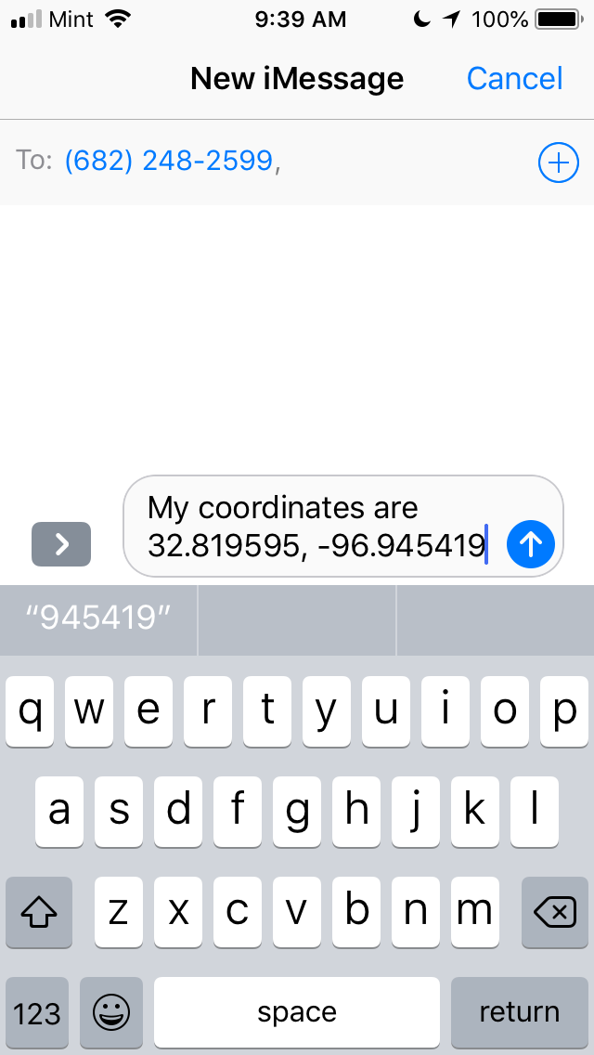
Send Location Page

Slide 5
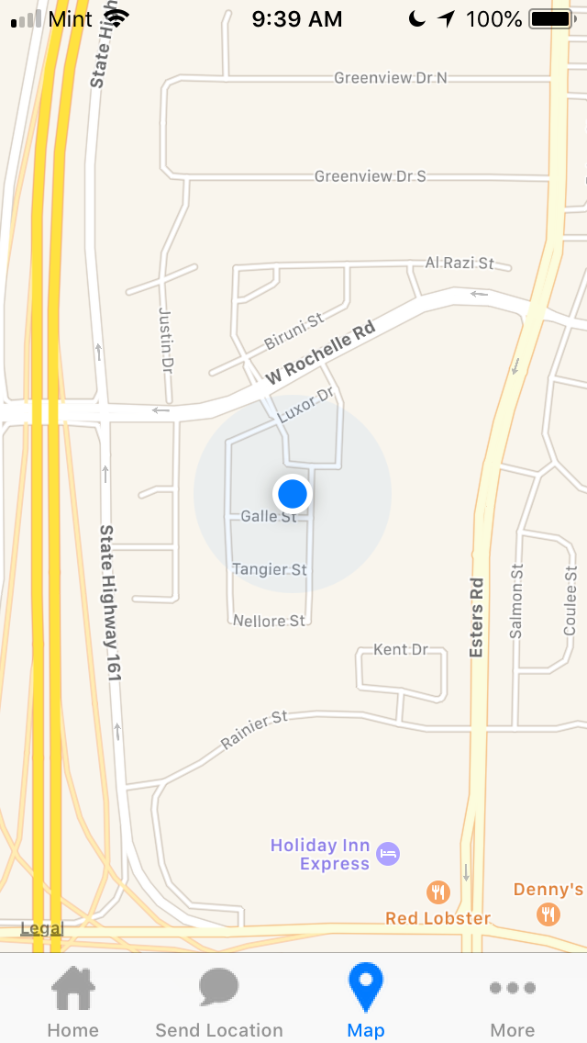
Map Page

Slide 6
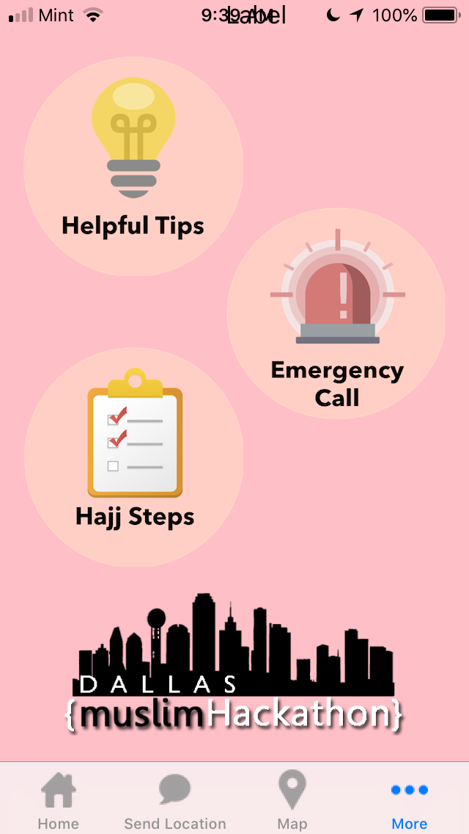
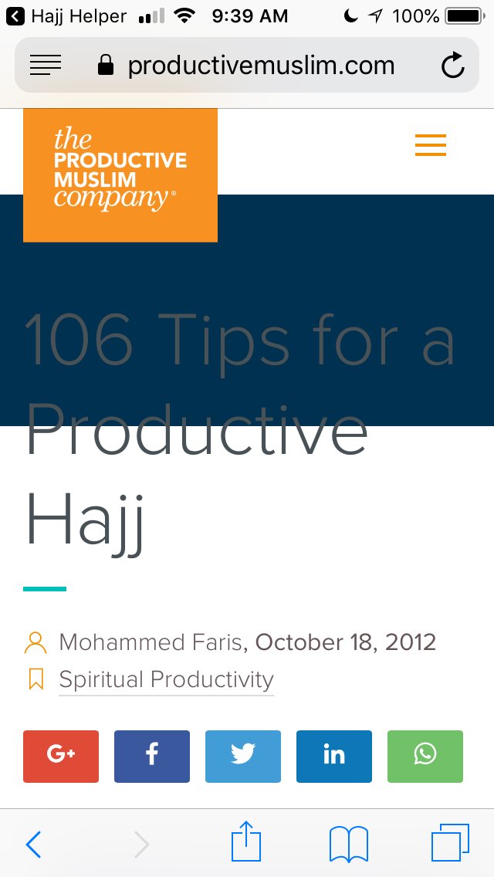
More- Helpful Tips Feature

Slide 7
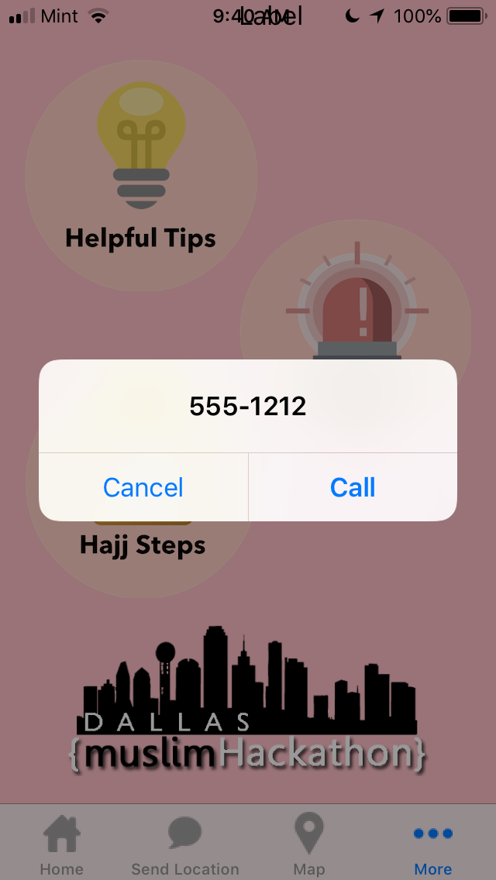
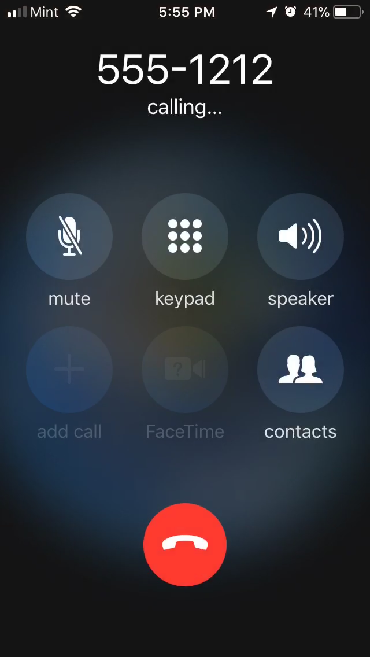
More- Emergency Call Feature

Slide 8
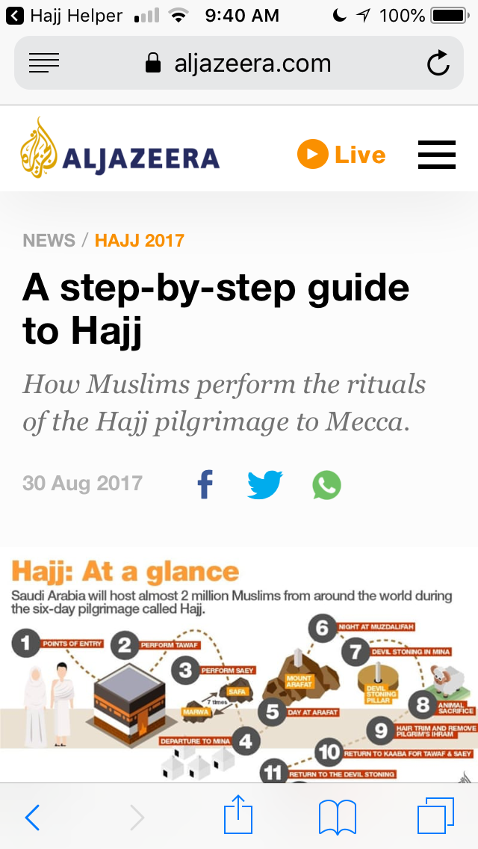
More- Hajj Steps Feature

Slide 9

Jazaakum Allahu Khairan

